Slide 1
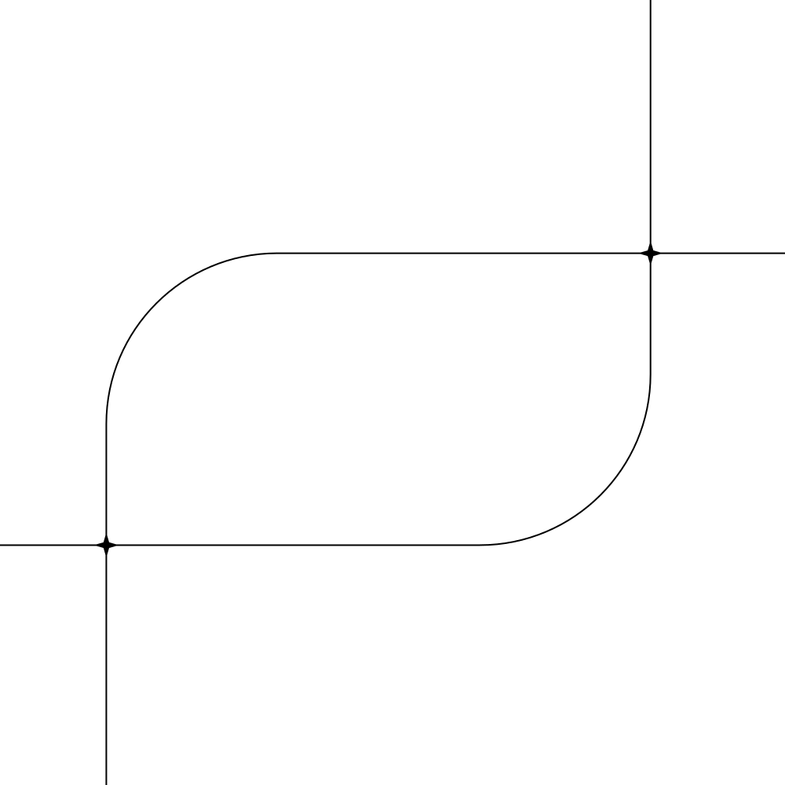
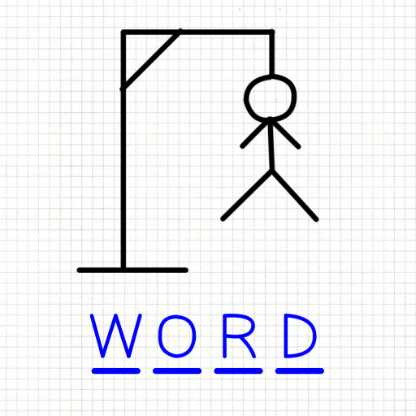
Hangman

Slide 2
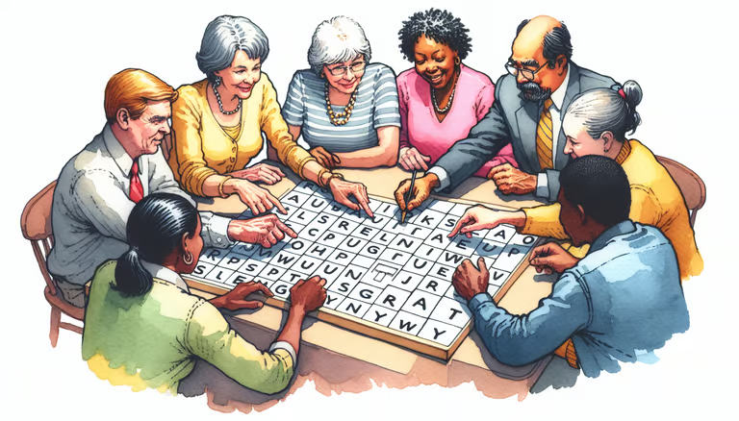
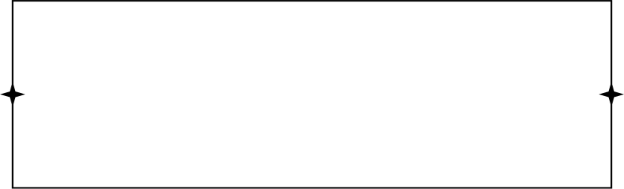
Introduction
Hangman is a word-guessing game where the player tries to guess a hidden word by suggesting letters. For each incorrect guess, a part of the stick figure is drawn until it is complete, resulting in the "hanging" of the figure.(but here there are only eight chances to guess the word).
How to play Hangman
Playing Hangman is simple and engaging. Players need to understand the rules of the game, follow the instructions, and use their vocabulary and deduction skills to guess the hidden word. The game is played in turns, with the player guessing a letter in each turn.
  The game starts by selecting a secret word randomly chosen by program.
  The player then guesses a letter that they think is in the word. Each correct guess reveals the letter's position in the hidden word.
  The process of guessing letters continues until the player either correctly guesses the entire word or the stick figure is fully drawn, indicating a loss.

Slide 3


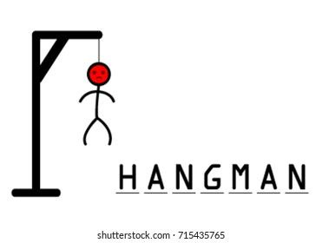

Rules
Rule 1: Alphabet Only
The player can only guess individual letters from the alphabet, one at a time.
Rule 2: No Repeating Letters
Players cannot guess the same letter multiple times in a single game. This prevents players from simply guessing all letters in the alphabet.
Rule 3: Letters Only
Players cannot guess whole words or phrases. They are limited to guessing individual letters only.
Rule 4: Guessing Ends When Chances are over
The player can continue to guess letters until given chances are over after which the game is over and the player loses.

Slide 4
Overview of Python
Python is a high-level, interpreted language known for its simplicity and broad applicability. Created by Guido van Rossum in 1991, it's widely used for web development, data science, machine learning, automation, and more.
Key Features:
- Readable: Easy-to-read syntax, great for beginners.
- Versatile: Supports tasks from web development to AI.
- Interpreted: Executes code line-by-line, simplifying debugging.
- Dynamic Typing: No need for explicit data type declarations.
- Large Library: Built-in support for tasks like regex and networking.
- Cross-Platform: Runs on Windows, macOS, and Linux without changes.
Popular Libraries:
- Web Development: Django, Flask
- Data Science/ML: Pandas, TensorFlow, Scikit-learn
- Automation: Selenium
- GUI: Tkinter, PyQt
Why Choose Python?
- Easy to learn, vast library support, strong community, ideal for all scales of development.

Slide 5
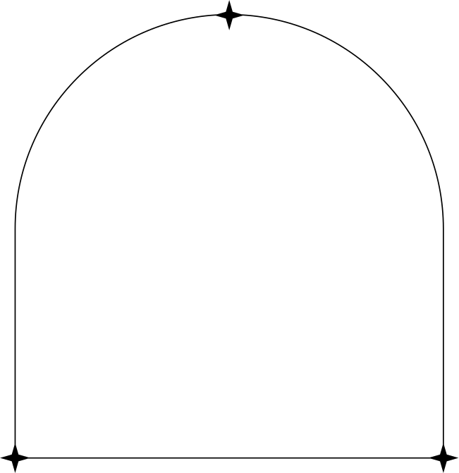


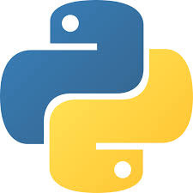
Concepts Used in Implementing
Conditional Statements :
Conditional statements like if,if else,if elif else are used to check whether the given letter by user exists in the word or not.
Loops:
While loop is used to iterate until the given chances are comoketed and gives the final result of the game.
Functions:
Functions are used to make the code easy to understand and increases the reusability of the code.There are 6 functions defined in this code .

Slide 6

Words.txt:
This progam uses the external file words.txt in which the words for the game are defined already.
Random module:
Random is a module in which it is used to choose a word ramdomly from the text file .
String module:
String module is used to do string manupulation or any other operations by usinf the predefined functions in the string module.

Slide 7
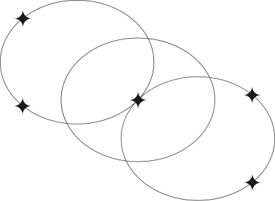
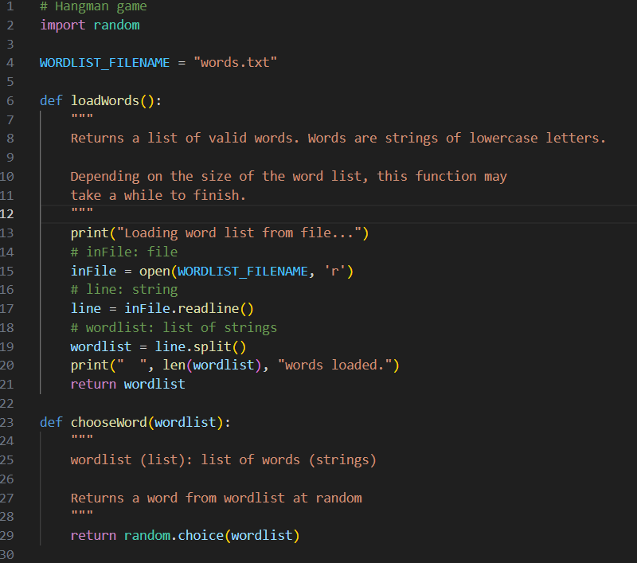
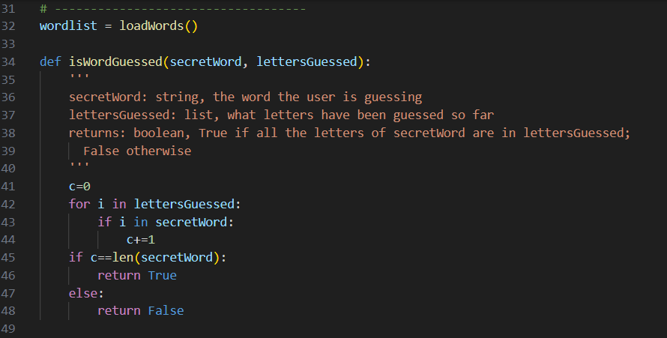

Code

Slide 8
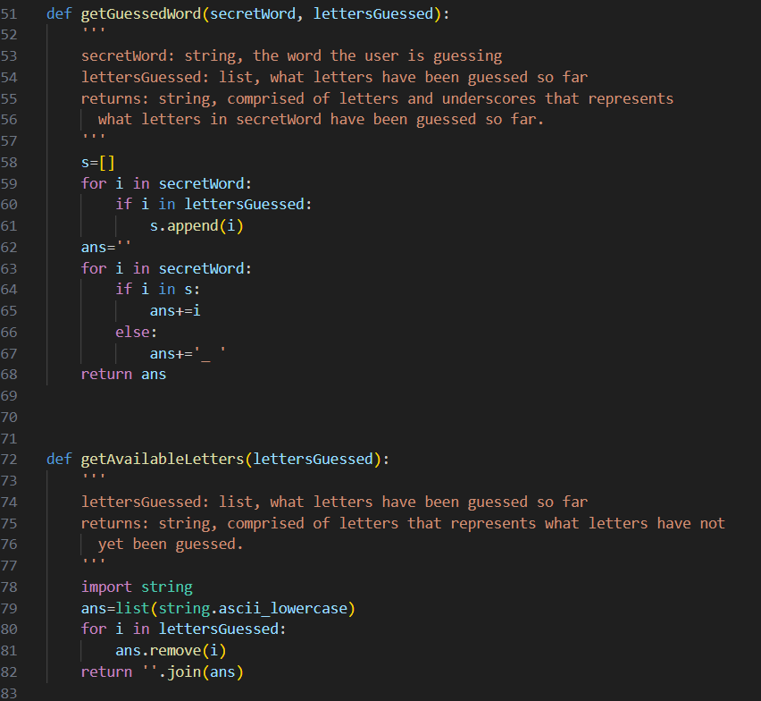
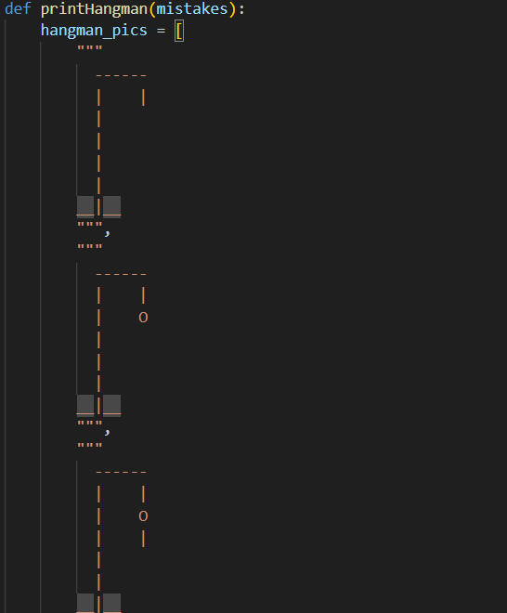
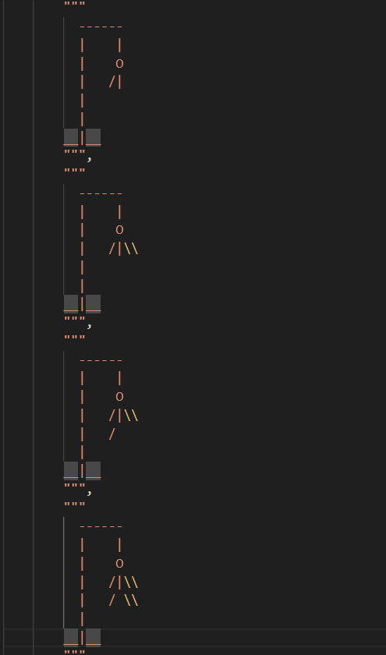


Slide 9
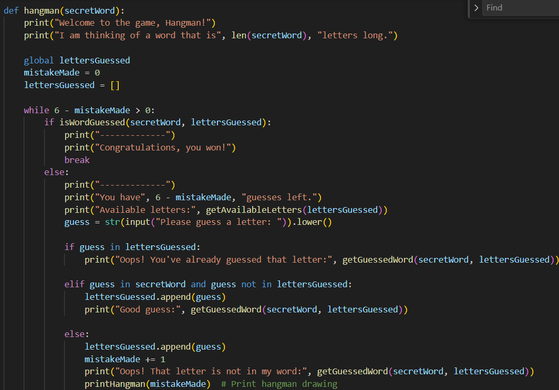
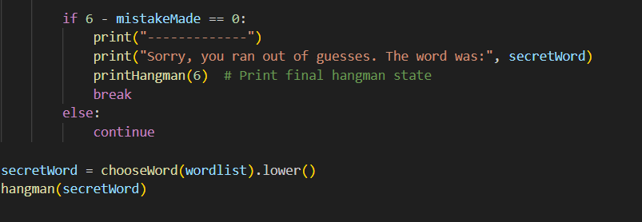

Slide 10
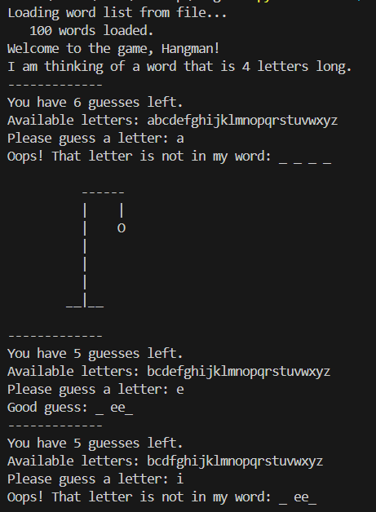
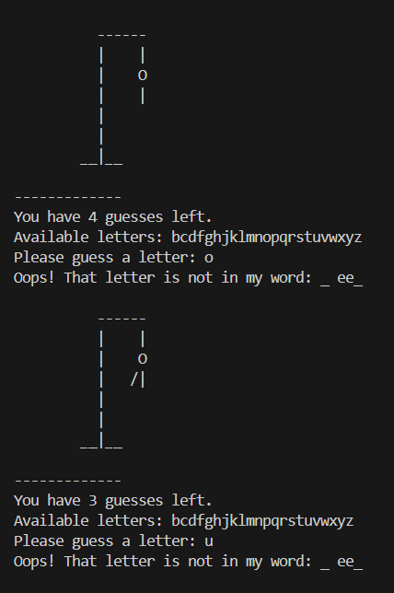
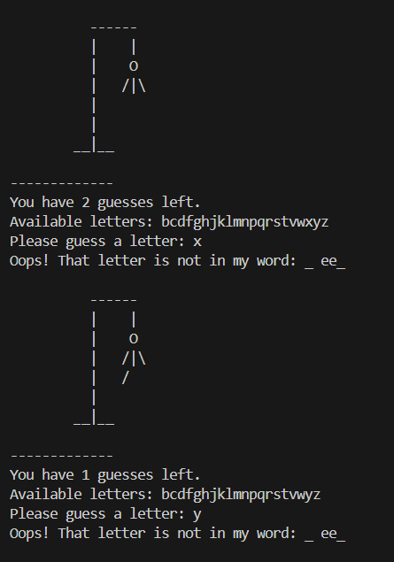
OUTCOMES

Slide 11
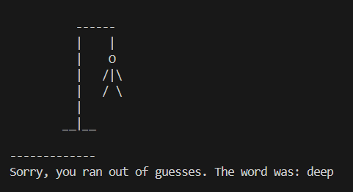
OUTCOMES

Slide 12

THANK YOU

